Slide 1
IMAGE RETRIEVAL using CIFAR dataset TEAM MEMBERS: NIKHIL REDDY DUGGIREDDY - 1001968033 LAYA KALALI - 1002128876 SASIKALA PATURU - 1002083123 LOKESHWAR KODIPUNJULA. - 1002175121

Slide 2
INTRODUCTION:
Image retrieval uses machine learning to find and retrieve images from a dataset based on a query, like another image or text. This presentation demonstrates building an image retrieval system with the CIFAR-10 dataset, using deep learning and CNNs to create feature embeddings that allow efficient similarity searches. Applications include e-commerce recommendations, social media content suggestions, and case-based retrieval in medical imaging.

Slide 3
CIFAR Dataset Overview:
The CIFAR (Canadian Institute For Advanced Research) dataset is one of the most widely used datasets in computer vision and machine learning. Developed by Alex Krizhevsky, Vinod Nair, and Geoffrey Hinton, it is used to train and evaluate image classification models due to its simplicity, size, and diversity of classes.
Key Details of CIFAR-10 Dataset
Total Images: 60,000 images, each with a resolution of 32x32 pixels.
Color Channels: All images are in RGB, containing three color channels.
Class Distribution: Divided into 10 classes, each class containing 6,000 images, making it a balanced dataset.
Training and Testing Split:
Training Set: 50,000 images
Test Set: 10,000 images

Slide 4
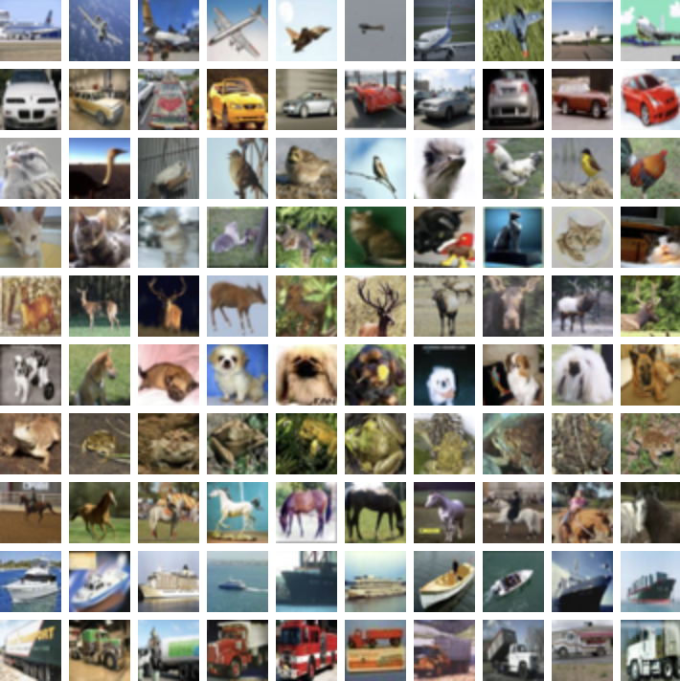
The dataset is divided into five training batches and one test batch each with 10000 images. The test batch contains exactly 1000 randomly-selected images from each class. The training batches contain the remaining images in random order, but some training batches may contain more images from one class than another. Between them, the training batches contain exactly 5000 images from each class.
Each image in CIFAR-10 belongs to one of the following 10 mutually exclusive classes:
1.Airplane
2.Automobile (cars and trucks)
3.Bird
4.Cat
5.Deer
6.Dog
7.Frog
8.Horse
9.Ship
10.Truck
These classes represent common objects, making CIFAR-10 a relevant dataset for general object recognition tasks.

Slide 5
Architecture of Image Retrieval System
Data Preprocessing: Load CIFAR-10 images, normalize, and optionally apply augmentations.
Feature Extraction: Use a pre-trained CNN (e.g., ResNet) to create high-dimensional feature embeddings that capture image characteristics.
Similarity Search: Store embeddings in a vector database; generate embeddings for query images and retrieve similar images by calculating similarity scores (cosine or Euclidean).
Efficient Retrieval: Use vector indexing (e.g., FAISS) for fast similarity searches.
Evaluation: Assess retrieval quality with metrics like precision and recall.

Slide 6
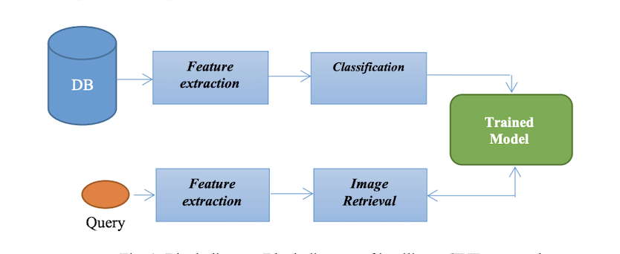
ARCHITECTURE
Fig. 1: Block Diagram of CBIR Approach

Slide 7
CHALLENGES
Feature Quality: Ensuring embeddings capture complex visual details accurately.
Real-Time Performance: Balancing speed with retrieval accuracy for large datasets.
High-Dimensional Embeddings: Managing memory and computational costs for detailed embeddings.
Diverse Query Handling: Adapting to both image and text-based queries for flexible retrieval.

Slide 8
FUTURE DIRECTIONS
Larger Datasets: Extend to high-resolution datasets like ImageNet for richer, real-world retrieval.
Enhanced Embeddings: Use advanced models (e.g., EfficientNet, ViTs) for more accurate, discriminative embeddings.
Multimodal Retrieval: Incorporate text-to-image retrieval with multimodal models like CLIP.
Faster Search: Implement Approximate Nearest Neighbor (ANN) algorithms for quicker, scalable searches.

Slide 9
CONCLUSION
We built an image retrieval system with CIFAR-10, using deep learning to extract feature embeddings and retrieve similar images efficiently. While CIFAR-10 allowed us to explore the basics, future improvements in scalability, embedding quality, and multimodal capabilities will enhance real-world applications. This project showcases the promise of image retrieval, setting a strong foundation for further advancements in speed, accuracy, and user experience.

Slide 10
THANK YOU

